Slide 1



Welcome to the
2025-2026
Annual Parent Meeting About the Benefits
of the Title I Schoolwide Program
Lincoln- Marti Charter Schools Hialeah / 5007
September 18, 2025
4:00 PM
School Theater
Idelmis Clavijo_ Principal
Mirelys Garcia_Assistant Principal
Notes:
This presentation may be utilized for virtual and/or in person meetings. All schools are required to update the presentation with the school’s information (see red sections on each slide). Suggested meeting duration is one hour and separate from Open House.
Ensure Annual Parent Meeting About the Benefits of the Title I Schoolwide Program sign in sheet is available for all participants.
Schools are encouraged to insert pictures/graphics/videos into their presentation.
Families should be encouraged to provide input and feedback throughout the meeting.
The purpose of this presentation is to provide required Title I information with parents and families as well as fully engage them with the presentation.
To engage the audience, the presenter may provide opportunities for participants to answer slide title questions, read slide information, ask questions, respond to questions, and share.
Other ideas to engage the audience; have students assist with the presentation, have a post-it note board for questions, have audience use technology (Phones, laptops, computer lab setting, iPad etc.) to follow along and use live links included in the presentation, take photos during the presentation and post, use links as virtual field trips and scavenger hunts to find information, use technology for participation during the presentation (examples: Kahoot, Mentimeter, Quizlet)
Please designate someone to take meeting minutes that follow the presentation topics and that can later be made available to parents/families and is kept in the Title I Compliance e-filing System.

Slide 2

What topics will you learn about today?
  Meet Your School Team
  All About Title I
  Coordination with Other Federal Programs
  Title I District-Level Parent and Family Engagement Plan (PFEP)
  Title I School-Level Parent and Engagement Plan (PFEP)
  Title I School-Parent Compact
Notes:
Note: Slides #1, #2, and #3 (2 slides per page) should be printed and placed in folder VI.3 of the Title I School-level Compliance e-filing System with the meeting flyer in multiple languages, with the access and accommodations disclaimer, and the attendance records (in corresponding month) of the Title I School-level Compliance Filing system.
To engage participants - Ask the title question and have participants read bullets.

Slide 3
What topics will you learn about today?
  Parents, Families, and Schools Working Together
  School Improvement Plan (SIP)
  School Achievement and Performance Data
  Parent’s Right-to-Know
  School-Level Parent and Family Engagement Feedback Form
  Consultation and Complaint Procedures
  School Contact Information
Notes:
Note: Slides #1, #2, and #3 (2 slides per page) should be printed and placed in folder VI.3 of the Title I School-level Compliance e-filing System with the meeting flyer in multiple languages, with the access and accommodations disclaimer, and the attendance records (in corresponding month) of the Title I School-level Compliance Filing system.
To engage participants - Ask the title question and have participants read bullets.

Slide 4
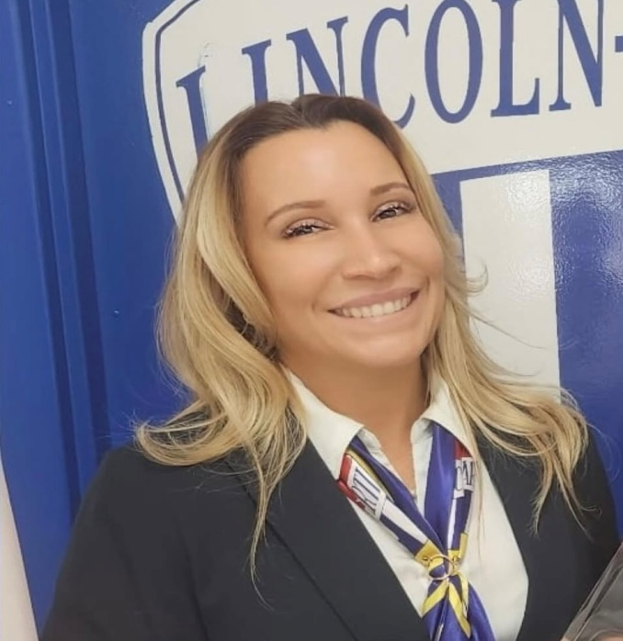
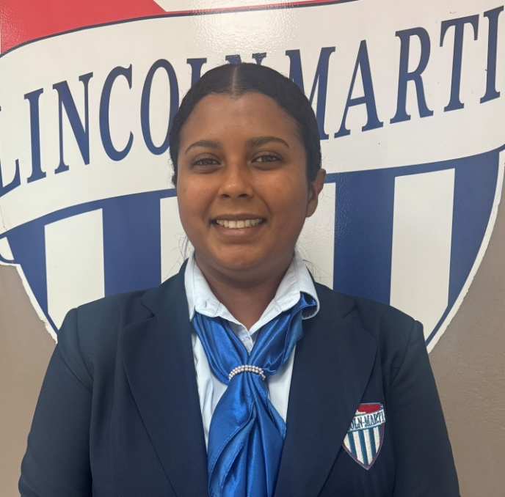

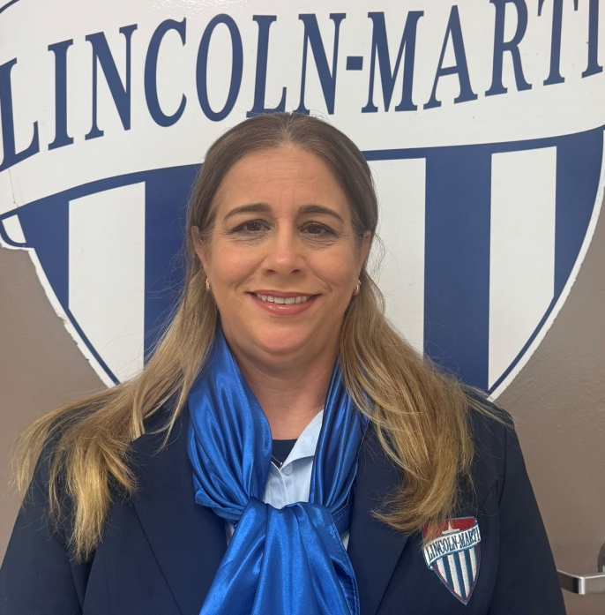
Meet Your School Team
Idelmis Clavijo
Principal
Karla Mendoza
Nathaly Perez
Registrar
School Counselor
Mirelys Garcia
Assistant Principal
Notes:
Allow school staff to greet parents/families. Encourage school staff to insert pictures so parents and families may be able to view this presentation later if archived, and for easier identification of relevant staff.

Slide 5

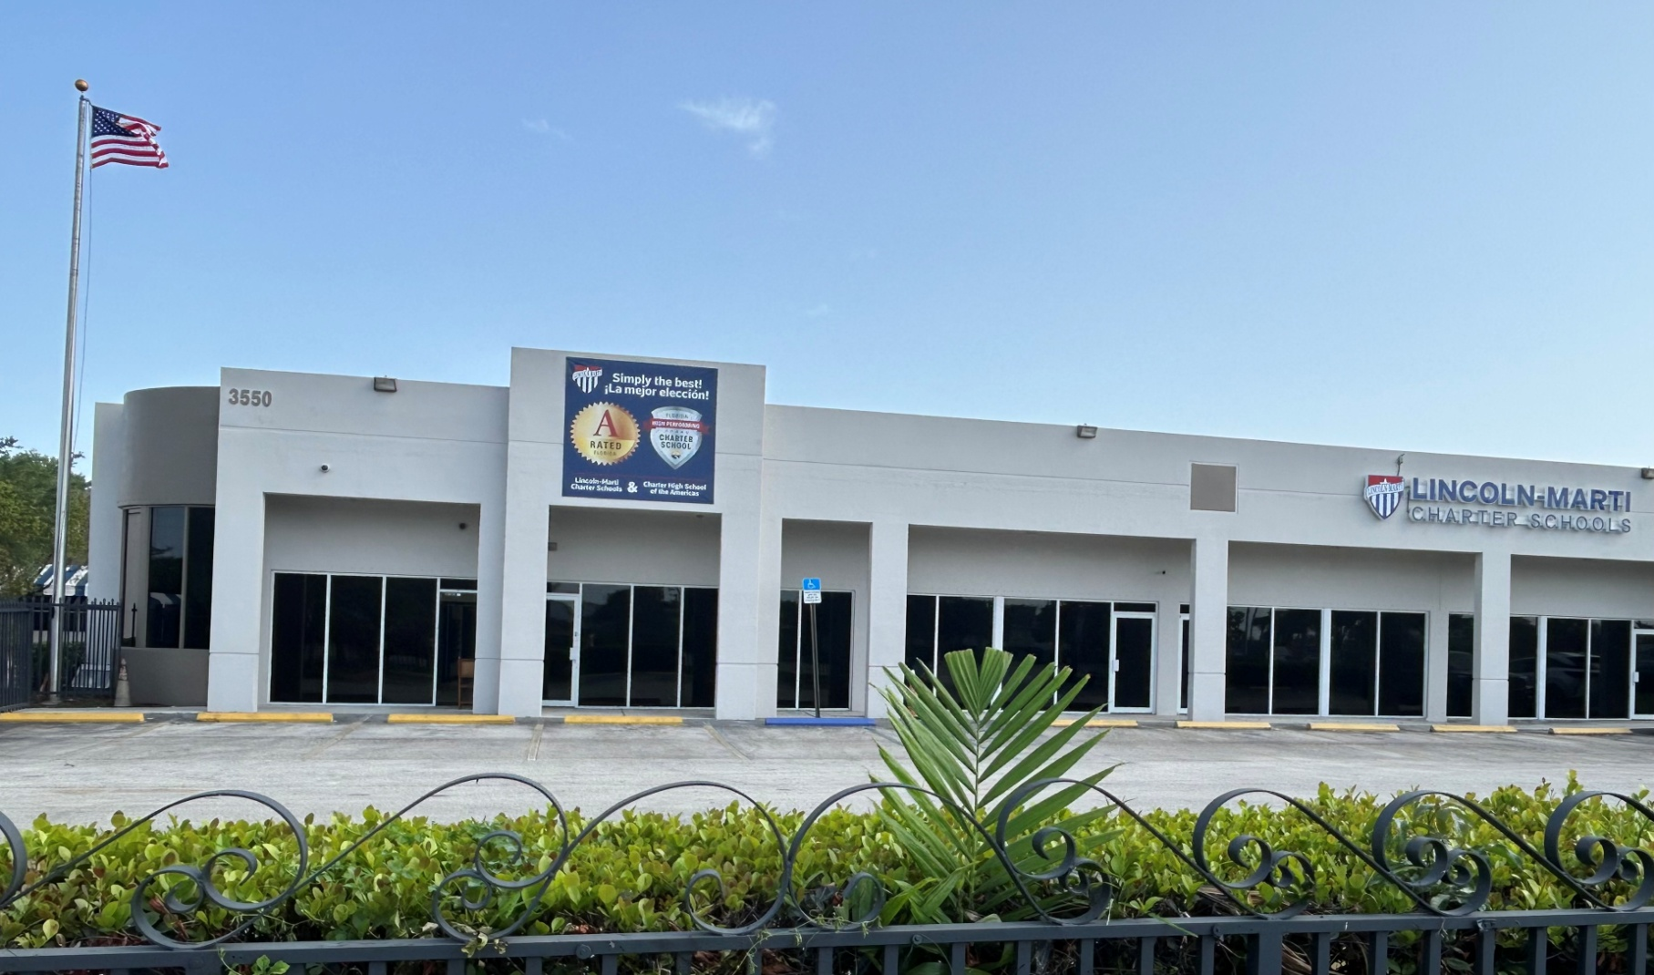
All About Title I
What is the purpose of this meeting?
Federal guidelines require Title I schools to hold an Annual Parent Meeting About the Benefits of the Title I Schoolwide Program to inform parents of Title I requirements and discuss their rights to be involved in the Title I Schoolwide Program.
Lincoln- Marti Charter Schools Hialeah is a Title I School
Notes:
Slides #5 and #6 go together.
If possible, include a welcome message on your website and marquee for students, parents & families. You may also include a slide showing the school marquee message.

Slide 6



All About Title I (Cont’d.)
Title I is the largest federally funded education program under the Every Student Succeeds Act (ESSA), current federal education law in the United States, governing K-12 public education.
  It is designed to provide students with additional help in Reading, Language Arts, Mathematics, Science and Social Studies.
  The main objective is to support schools and districts to ensure that high quality education is equitable for all students.
  The Title I Schoolwide Program is committed to helping schools close the achievement gap between disadvantaged and minority students and their peers.
  To learn more, please visit https://title1.dadeschools.net/#!/ . This website is designed to provide visitors with information relevant to Title I and to offer a clear understanding of the overall program.
Notes:
To engage participants – Allow participants to provide input/enter comments/questions. Use this opportunity to ask questions (example, How many of you have heard of the Every Student Succeeds Act EESA? Yes/No, Does anyone know when it was signed into law? 2015).
To engage participants- Have participants use link to visit the Title I website.

Slide 7

All About Title I (Cont’d.)
How does the ESSA law and the Title I Parent and Family Engagement requirements help parents and families?
  The school district and all Title I schools must allocate a portion of their Title I budget towards programs, activities, and procedures for parent and family engagement.
  The school district and all Title I schools must develop with parents and families a written Title I Parent and Family Engagement Plan (PFEP). The PFEP must be distributed to all stakeholders.
  All Title I schools are required to collaborate with parents and families in the development of the School Improvement Plan (SIP) and School-Parent Compact.
https://lincoln-marticharters.com/general-programhial/
Notes:
Inform meeting participants that the 2025-2026 Title I School-level PFEP, District-level PFEP, SIP, and School Parent Compact will be located on the school’s website, the PRC/Area and the main office.
To engage participants – Have participants read the bullet points from the slide.
To engage participants – Use link to navigate school website and view documents.
To engage participants – Ask the title question and allow the opportunity for parents/families to share their comments. Read aloud some of the responses.

Slide 8


All About Title I (Cont’d.)
Where can you access Title I Compliance Documents?
  Documents are now available at your child’s school at the:
    School’s Parent Resource Center or Parent Area
    School’s Main Office
    School’s Website
  The 2025-2026 Title I Notification Flyer includes information about the availability of the documents and a link/QR code to access the District-Level PFEP.
Notes:
Inform meeting participants of the availability of the Title I Parent Notification Flyer posted on the school’s website. The PRC/Area. Main Office, and at title1.dadeschools.net. Provide directions for accessing the flyer.

Slide 9
All About Title I (Cont’d.)
How is Title I Funding provided for your child’s school?
  A portion of the Title I Schoolwide Funds are used to fulfill the parent and family engagement requirements in the ESSA law and provide supplemental materials and resources. The Educational Excellence School Advisory Council (EESAC) is an additional meeting to discuss the details of Title I funding.
      Schoolwide Funds
Amount of funds allocated for this school year:
$74,815.00
      Title I Parent and Family Engagement Funds
Amount of funds allocated for this school year:
$1,145.00
Notes:
Inform meeting participants that they may view additional information and guidelines on how Title I funds are to be utilized in the Title I Procedures Manual, located on the Title I website under the School-level Compliance tab. Provide the calendar/schedule of EESAC meetings to participants and invite them to attend.
To engage participants – Ask for input regarding how to best allocate the school’s available Title I funds (share how the funds were used the previous year) allow participants an opportunity to respond. Read aloud some of the responses. Ensure the responses are recorded in the meeting minutes.

Slide 10
Coordination with Other Federal Programs
What other federal programs are offered at our school?
Project
UP-START
Notes:
Note: Schools should only include the federal programs available at their school. Describe how the school will coordinate and integrate parent and family engagement programs and activities with each Federal Program, as applicable.

Slide 11
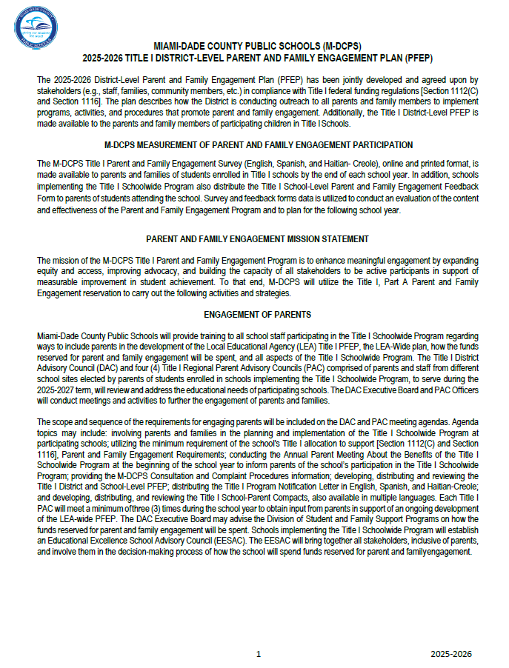
Title I District-Level Parent and Family Engagement Plan (PFEP)
  The District-Level PFEP is a blueprint of how the District and Title I schools will work together with parents and families to establish expectations for family engagement and explore strategies to improve student academic achievement.
  The District-Level PFEP describes how the District will:
    Provide coordination, technical assistance, and other support necessary to assist schools in planning and implementing effective parent and family engagement activities.
    Conduct, with meaningful involvement of parents and families, an annual evaluation of the content and effectiveness of the Parent and Family Engagement Plan towards improving the academic quality of all schools implementing the Title I Schoolwide Program.
Notes:
Schools may include a link to the Title I District-level PFEP on this slide and provide directions for accessing it on the school’s website.
To engage participants – Ask where can the District-level PFEP be located? (Title I web site, school web site, PRC/Area, and the main office)

Slide 12
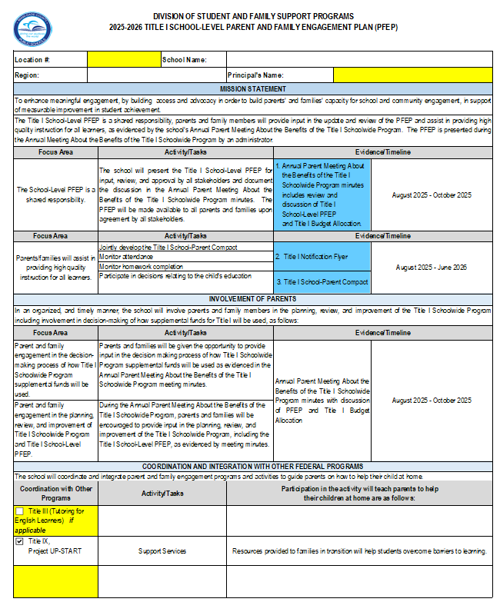

Title I School-Level Parent and Family Engagement Plan (PFEP)
  The Title I School-Level PFEP is a blueprint of how Lincoln- Marti Charter Schools Hialeah will work together with parents, family members, and the community to establish expectations for family engagement and to explore strategies to improve student academic achievement.
  The 2025-2026 Title I PEEP will be made available to all parents in the Parent Center/Area, Main Office and School website.
Notes:
Note: Slides #12, #13, and #14 go together.
Ensure the topic, Title I School-level PFEP is recorded in the meeting minutes.
To engage participants - Allow meeting participants to provide feedback on the information presented. Ask if there are any questions/feedback.
To engage participants - Provide an opportunity for meeting participants to share how they prefer to receive information from the school.

Slide 13
Title I School-Level Parent and
Family Engagement Plan (PFEP) (Cont’d.)
  Our Title I School-Level PFEP describes how our school will:
    Convene an annual meeting to inform parents and family members of their rights to be involved in the Title I Schoolwide Program; Participate in parent/teacher conferences; Invite family members to visit classrooms during designated times to observe a typical day in the school life of their child; Extracurricular Activities; Tutoring Programs; Especial Events; Family- Teachers Workshops.
    Offer meetings at flexible times to maximize participation;
    Provide parents and family members with timely information about Title I programs;
    The parents will be contacted via flyers, black board connect messages, school website, Apps, and Letters.
Notes:
Schools may include a link to the Title I District-level PFEP on this slide and provide directions for accessing it on the school’s website.
To engage participants – Ask where can the District-level PFEP be located? (Title I web site, school web site, PRC/Area, and the main office)

Slide 14
Title I School-Level Parent and
Family Engagement Plan (PFEP) (Cont’d.)
  Involve parents and families in the process of planning, reviewing, and improving documents required by the Title I Program and schoolwide activities in an organized and ongoing timely manner;
  Assist parents and families with understanding academic content standards, assessments, and how to monitor and improve the academic achievement of their children; and by participating in open houses, School Webinars and Workshops, and Teacher- Parent Conferences.
  Provide training to assist parents and families of students enrolled in schools implementing the Title I Schoolwide Program to improve academic achievement by inviting parents and families to participate in school- related activities, meetings, and workshops.
Notes:
Schools may include a link to the Title I District-level PFEP on this slide and provide directions for accessing it on the school’s website.
To engage participants – Ask where can the District-level PFEP be located? (Title I web site, school web site, PRC/Area, and the main office)

Slide 15
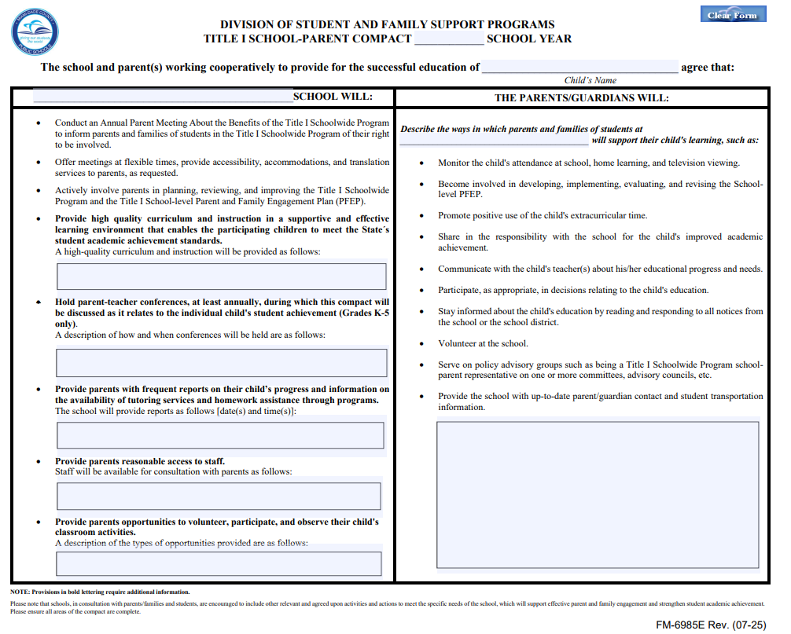
Title I School-Parent Compact
  Each Title I school must have a School-Parent Compact that is developed jointly by parents and school personnel.
  The compact sets out the responsibilities of the students, parents, and school staff in striving to raise student academic achievement.
  The compact will be discussed and amended during parent-teacher conferences and documented in a teacher communication log (K-5 only).
https://lincoln-marticharters.com/general-programhial/
Notes:
To engage participants – Access the School-Parent Compact using the link and review/discuss the School-Parent Compact with participants and allow time for feedback/comments.

Slide 16


Parents, Families and Schools
Working Together
  What does school and parent collaboration look like?
    Our school fosters collaboration with families by offering activities, training sessions, workshops, and parent-teacher conferences at flexible meeting times. On October 8, there will be a workshop to inform and assist parents on how to navigate the FAST Portal and comprehend student data reports. We also provide a Parent Resource Center/Area to support family engagement.
    School and parent partnerships are strengthened through participation in advisory councils such as the Educational Excellence School Advisory Council (EESAC), the Title I District Advisory Council (DAC), and the North Parent Advisory Council (PAC).
    Members of the Title I DAC and Region PAC are parent representatives who consult with the District Title I DAC about the planning and implementation of the Title I Schoolwide Program.
Notes:
Note: Slides #16 and #17 go together.
To engage participants – Survey parents regarding their input on how to best collaborate with the school.
Inform meeting participants of the method the school will utilize to inform parents/families of upcoming meetings, etc. Describe how meeting notices/invites (including virtual meetings) will be sent/made available to parents/families. Describe how the school will keep all parents informed, specifically parents who may be unable to attend virtual/in person meetings (ex. archived virtual meetings).

Slide 17
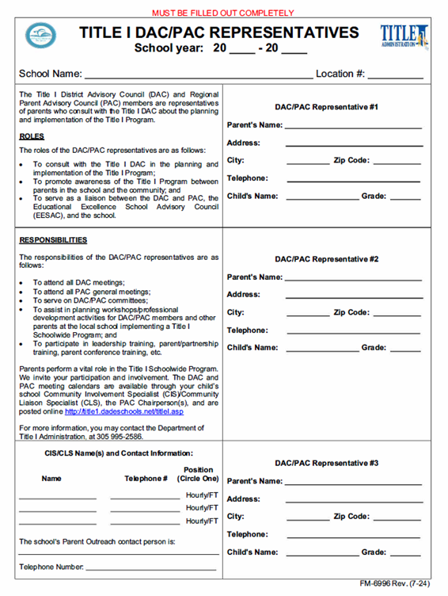
Parents, Families and Schools
Working Together (Cont’d.)
  The school conducts elections for Title I DAC/PAC Representatives.
We will now open the floor for nominations for parents to serve as DAC/ PAC representatives for our school.
Title I DAC/PAC Representatives (FM 6996)
Notes:
Note: Slides #16 and #17 go together.
To engage participants – Open the floor for nominations to service as Title I DAC/PAC Representatives for your school.
Inform meeting participants that the Title I District Advisory Council and Parent Advisory Council Meetings will be conducted in-person and virtually. Additional information regarding the Title I DAC and PAC meetings will be forthcoming. Encourage meeting participants to visit the Title I Website for additional information regarding Title I DAC and PAC.

Slide 18


School Improvement Plan (SIP)
  What is our School Improvement Plan (SIP)?
    The School Improvement Plan (SIP) at Lincoln- Marti Charter Schools Hialeah is developed with all stakeholders to be utilized by our school to review data, set goals, create an action plan and monitor progress.
Notes:
Note: Slides #18 #19, and #20 go together.
Remind meeting participants where they can view the SIP.

Slide 19
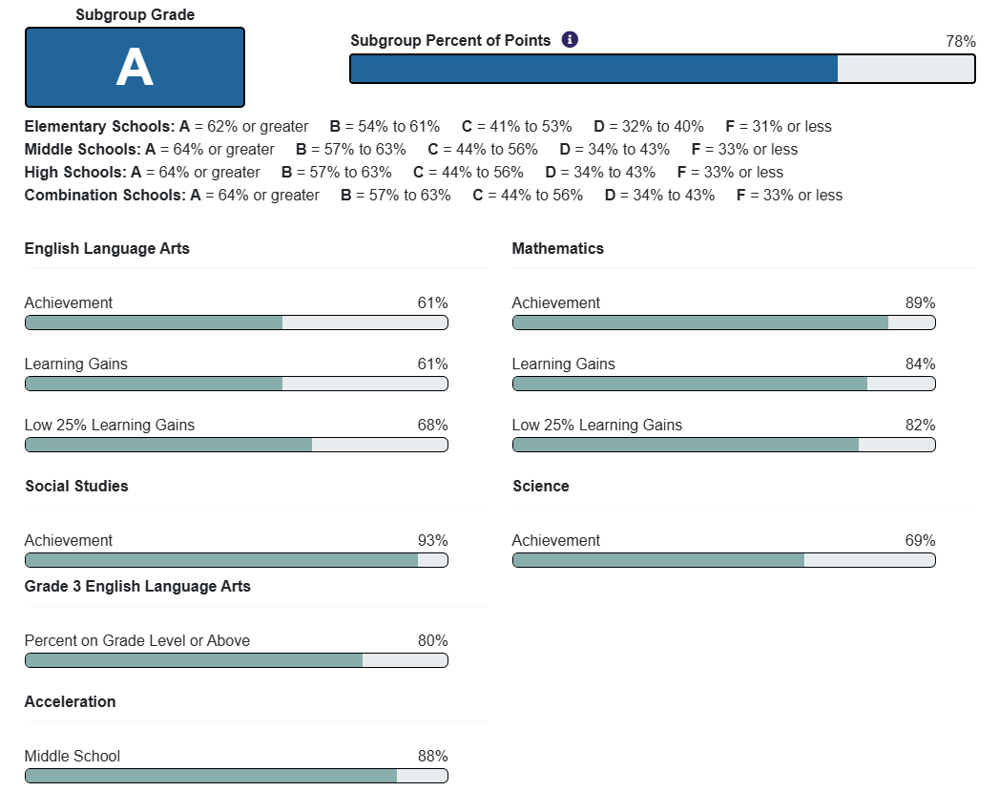
School Achievement Performance Data
  Our School’s Goal for 2025-2026
      80%
      ELA: From 61% to 65%
      Math: From 89% to 92%
      Science: From 69% to 72%
      Social studies: From 93% to 95%
Notes:
Note: Slides #18 #19, and #20 go together.

Slide 20

School Achievement Performance Data (Cont’d.)
  How do we use our school achievement data?
    Our school uses data to align the curriculum to State and District academic standards.
    Our instructional practices are adjusted based on the findings of the assessment data.
    For further details about our school achievement data, we invite you to attend the EESAC meetings throughout the school year.
Notes:
Note: Slides #18 #19, and #20 go together.
To engage participants - Allow the opportunity for meeting participants to provide input/feedback. You may ask questions based on the information discussed.

Slide 21

Parent’s Right-to-Know
  Parents have the right to request and receive timely information regarding the professional qualifications of their child’s teachers and paraprofessionals.
  Parents must be notified if their child is assigned to, or taught by, a teacher who does not meet state certification requirements for the grade level or subject area for four (4) or more consecutive weeks.
  Parents should be provided information regarding the level of academic achievement of their child on State required academic assessments.
  To the extent that it is feasible, information must be in a language that parents can understand.
Notes:
Inform meeting participants how each Parents Right-to-Know communication will be provided by the school.

Slide 22

School-Level Parent and Family Engagement Feedback Form
  Please complete the 2025-2026 Title I School-Level Parent and Family Engagement Feedback Form distributed today.
  The results of this survey will be utilized to help in the development of the School-Level Title I Parent and Family Engagement Plan (PFEP), and to plan future parent and family engagement activities, events, and workshops at Lincoln- Marti Charter Schools Hialeah.
Notes:
Inform meeting participants how each Parents Right-to-Know communication will be provided by the school.

Slide 23
Consultation and Complaint Procedures
  A student, parent or employee, who in good faith believes that the District has violated federal and state law pertaining to the delivery of Title I services and programs, may take action to resolve these allegations.
  More information can be found in the Parent and Family Engagement Section of the 2025-2026 Division of Student and Family Support Programs Procedures Manual.
Parent and Family Engagement Section of the
2025-2026 Division of Student and Family Support Programs Procedures Manual
Notes:
An administrator will include an overview of the Consultation and Complaint Procedures at the school as stipulated in the Title I Consultation and Complaint Procedures (See page 14-15 of the 2025-2026 Title I Procedures Manual).

Slide 24



School Contact Information
  Lincoln- Marti charter Schools Hialeah
  3550 W 84th St Hialeah, FL 33018
  https://lincoln-marticharters.com/lincoln-marti-charter-hialeah-campus/
  (305) 827-8080
  school96@lincoln-marti.com
  School Hours_ 6:00 am- 5:00 pm
  Follow us on Instagram
Notes:
Insert your school information

Slide 25

Questions, Comments and Feedback
Notes:
Address questions and concerns from participants. Inform how the school will respond to all questions/concerns posed/posted on the post-it note question board during the meeting if time does not permit.

Slide 26
Thank you!

